Slide 1
Types of Information Systems

Slide 2
Objectives
What are the 4 types of information systems?
How are they different?
Who are the primary users?

Slide 3
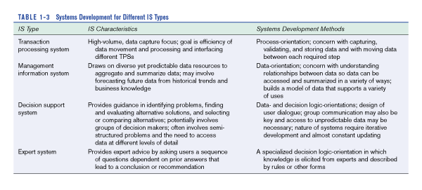
Types of Information Systems

Slide 4
Transaction Processing Systems (TPS)
Transaction processing systems automate the handling of data about business activities or transactions.
TPS: large number of transactions (writes to database), involves/produces small amount of data, used by operatives.
TPS are information systems that process data resulting from the occurrence of business transactions.
Example: payroll system; production instructions

Slide 5

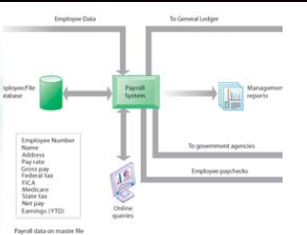
Payroll System

Slide 6
STAGES OF TRANSACTION PROCESSING
Five Stages Of Transaction Processing
Data Entry
Processing
Database Maintenance
Document And Report Generation
Inquiry Processing

Slide 7
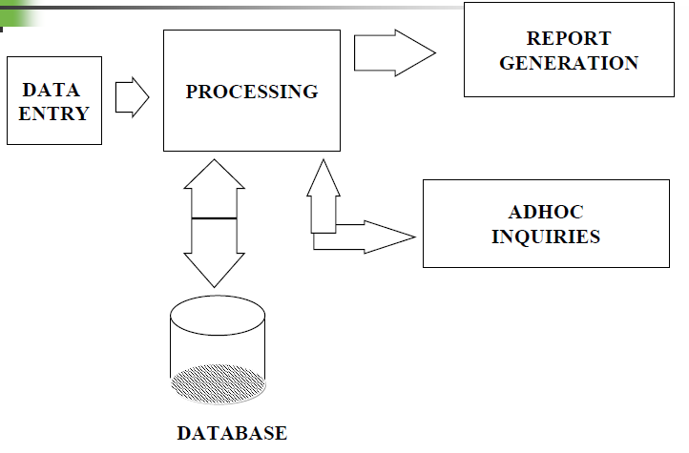

Slide 8
MIS
MIS provides information for managing an organization
  Extract and summarize data from TPSs
  Allow managers to monitor & direct the organization
  Provide accurate feedback
  Provide pre-specified reports on a scheduled basis
    Top managers make strategic decisions
    Middle managers make tactical decisions
    Line managers make operations decisions
    knowledge workers create and integrate knowledge
    Clerical workers use and manipulate information

Slide 9
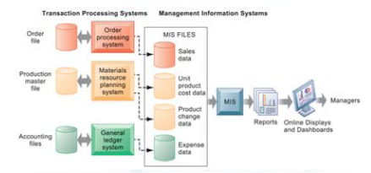

Slide 10
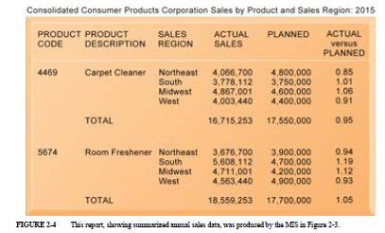

Slide 11
DSS
an interactive information system that provides information, models, and data manipulation tools to help make decisions in semi-structured and unstructured situations.
  Support analytical work
  Simulation and Optimization
    Simulation model –calculates the simulated outcome of tentative decisions and assumptions
    Optimization model –determine optimal decisions based on criteria supplied by the user, mathematical search techniques, and constraints

Slide 12
Serve middle management
Support nonroutine decision making
May use external information as well TPS / MIS data
Model driven DSS vs Data driven DSS

Slide 13
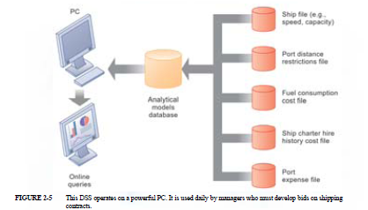

Slide 14
Tools of DSS
Online analytical processing (OLAP) :the use of data analysis tools to explore large databases of transaction data
Data mining: the use of analysis tools to find patterns in large transaction databases
Modeling
    Decisions involve many factors
    Uncertainty and risk present
    Statistical Analysis
    Risk Analysis
    Trend Analysis
Planning
    What-If
    Goal Seeking

Slide 15
EIS
A highly interactive system that provides a flexible access to information for monitoring results and general business conditions
Just DSS for executives
Each tool is designed specifically to support decision making at the executive levels of management
Primarily the tactical and strategic levels

Slide 16
DSS vs. MIS
MIS:
structured problems
designed to support a set of applications
DSS:
semistructured and unstructured problems
can be adapted to any decision environment

Slide 17
Expert System
An Expert System is an interactive system
  Responds to questions
  Asks for clarification
  Makes recommendations
  Helps the user in the decision-making process
Simulates human thought process
  Reasons, draws inferences & makes judgments (heuristic knowledge)
Information acquired from live domain experts
Highest form of knowledge-based systems, not an assistant system

Slide 18
Example
Printer - Replace technical support people
Diagnosis help (you relate symptoms and it asks for more info)
Assistant system (call center; life ins quotes)
Knowledge base contains
  Means of identifying problem
  Possible solutions
  How to progress from problem to solution

Slide 19
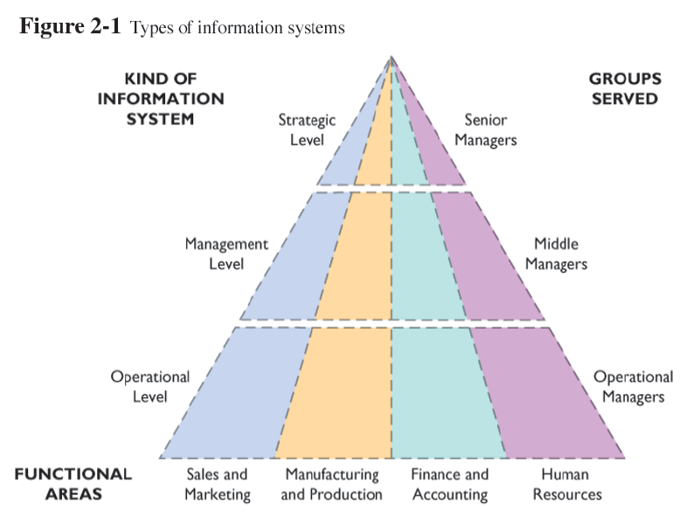
Level vs Area Fungsional

Slide 20
IS Level
Level 1-Transaction Processing Systems (TPS)
Level 2-Management Information Systems (MIS)
Level 2-Decision Support Systems (DSS)
Level 3-Executive Information Systems (EIS)

Slide 21
Lowest Level (operational)-Transaction Processing Systems (TPS)
Inputs:Transactions or events
Processing:Sorting; listing; merging; updating
Outputs:Detailed reports; lists; summaries
Users:Operational personnel; supervisors

Slide 22
Level two (management level)- Management Information System (MIS)
Inputs: Summary transaction data
Processing: Simple models; low level analysis
Outputs: Summary reports
Users: Middle managers
Example: Weekly, monthly, and annual resource allocation. Not five year plans and not daily details, but something in between.

Slide 23
level two (management level) - Decision Support System (DSS)
Inputs: databases optimized for statistical analysis
Processing: Interactive. Simulations and statistical analysis
Outputs: Responses to queries; statistical test results.
Users: Professionals, staff
Example: Could answer the following query: “We need to trim 5% of our menu offerings to limit complexity in operations. Which items are the worst performing; are most likely to lead to sales of other products left on the menu, and have the most ingredients unique to their recipes?”

Slide 24
Top level (strategic level)-Executive Support System (ESS)
Inputs: Aggregate data. Internal and external
Processing: Interactive and graphical simulations
Outputs: Projections
Users: Senior managers
Example: 5-year operating plan.
Answer question like “what are long-term industry cost trends and how are we doing relative to them?”
Gets data from all internal IS plus external industry data bases

Slide 25
Exercise. Match the type of information system with the organizational level where they are most commonly used:
  Transaction Processing Systems (TPS)
  Management Information Systems (MIS)
  Decision Support Systems (DSS)
  Expert Systems (ES)
Top
Managers
Middle
Managers
First-Line
Managers
Operatives

